Slide 1
Information Search Process
Concept and techniques

Slide 2
The Information Search Process
Basic features:
Whether it is manual or online searching, basic features of search processes are same. These are:
a) matching of information needs with the information available in IR system;
b) conducting the search with some criteria such as surrogates, exact form, etc.; and
c) subject surrogates are the main approach of information seekers.

Slide 3
Information Search
An information search may fall in one of the following three categories [Chowdhury, 2004]:
High recall search: when the user needs to find out all the relevant items on the stated topic. Recall is a parameter used to measure the performance of information retrieval systems; it is measured as the proportion of relevant items retrieved from a collection in a given search session;
High precision search: when the user needs only relevant items, i.e., as small a number of non-relevant items as possible. Precision is a parameter used to measure the performance of information retrieval systems; it is measured as the proportion of the retrieved items that are relevant in a given search session; and
Brief search: when the user wants only a few relevant items as opposed to all the relevant items.

Slide 4
Search tactics
The success of any search depends upon the tactics effectively adopted in conducting a search.
Bates, 1979 categorised it in four categories:
Monitoring tactics (to keep the search on a track)
File structure tactics (for traversing information within the system)
Search formulation tactics (to aid in the process of designing and redesigning the search formulation)
Term tactics (to select and reuse search terms)

Slide 5
For a successful search
Decide which particular database(s) is/are to be searched;
Guess the words that might have been used by the authors and the indexers in a database of potentially relevant documents;
Use the thesaurus of the chosen database in order to translate the query terms in the appropriate way (is in the language of the system);
Coordinate the terms (often using Boolean operators) to formulate the search statement;
Use the search features and search operators appropriate for the chosen database;
Input the search statement;
Repeat steps (e) and (f) until a desirable output is obtained or the search fails altogether; and
Identify the actual relevant items from among those retrieved.

Slide 6
Search Strategy and its Prerequisite
The advancements in information and communication technologies (ICT) brought out the possibility of more dynamic searching via online methods.
The concept of online searching has occupied a large and significant area in the study and research of modern information retrieval.
Online information retrieval systems appeared over four decades ago, and over the years they have developed significantly in terms of number, features and facilities.
However, a user often faces difficulties in approaching an online information retrieval system, especially in formulating an appropriate search statement.

Slide 7
Search Strategy
The cost of searching a database, whether in-house or external, can be reduced significantly if an appropriate strategy for searching is followed.
The search strategy helps the user select the optimum path for searching a file or a database.
This involves a number of measures that are to be taken before and during a search.

Slide 8
Search strategy
Search strategy is the action plan which is drawn to conduct a search.
It encompasses several steps and levels of work in information retrieval.

Slide 9
Issues to consider
the concepts or facets to be searched and their order;
the term(s) that appropriately represent(s) the search concept;
the feature(s) of the retrieval system concerned; and
the measures to be taken in revising a search statement.

Slide 10
The Pre-search Interview
The results of a search depend heavily upon the correct understanding of the users’ precise needs.
This understanding can be developed through a pre-search interview.
A pre-search interview is a conversation that takes place between a user and member of the information staff regarding the actual information requirement of the user.

Slide 11
Qualities of the interviewer
In order to conduct a successful pre-search interview, the interviewer should possess the following qualities:
ability to conduct personal communication;
conceptual skills;
analytical skills;
knowledge of file organisation;
understanding of indexing policy and vocabulary control; and
subject knowledge.

Slide 12
Functions of human intermediary
ascertain exact information needs of the users as far as possible,
identifying the concepts that describe the needs,
translating these concepts into the terms of IR system and delineating the relationships among them,
stipulating the parameters of the search.

Slide 13
Some other functions
The other functions are
selection of database(s) for search,
identification of alternative sources,
formulation of alternative search strategies,
matching of formulated search expression with the features of database(s), and
conducting past search review.
The queries of a searcher shift from actual need to unexpressed need. The need is refined to the conscious description need or conscious need which is finally formalized as formalized need.

Slide 14
Search strategy
Analytical strategy (mostly querying)
Analyze the attributes of the information need and of the problem domain (mental model)
Browsing
Follow leads by association (not much planning)
Known site strategy
Based on previous searches
Indexes or starting points for browsing
Similarity strategy
“more like this”

Slide 15
Search Techniques

Slide 16
SEARCH TECHNIQUES
Keyword and Phrase Search
Boolean Search
Truncation Search
Proximity Search
Field-Specific Search
Limiting Search
Range Search

Slide 17
Keyword and Phrase Search
A search can be conducted by entering a single search term or a phrase comprising more than one term.
Simplest form of search
The search terms can be entered through the keyboard or can be selected from an index or vocabulary control tool, such as subject headings lists or thesauri.
Phrase search, the system searches for the whole phrase.
Only the fields that are indexed for phrase searching can be phrase searched.

Slide 18
Phrase searching
This is most useful when the words to be searched are not very specific, have different meanings in various subject areas, or when it is important that the same word is repeated.
“Human Resource Management”
“Global Warming”

Slide 19
Boolean Search
Boolean Operators
Boolean operators are logical connectors that combine the keywords that you identify in the planning stage of your search.
The aim of this is to produce an exact statement of the topic you want to search, written in a way that the computer can understand.
OR
AND
NOT

Slide 20
Boolean Operators
Forget the usual meanings of the words in everyday language.
OR
The OR operator combines equivalent words.
These words should mean the same thing–synonyms and variant spellings.
It effectively makes your search broader.

Slide 21
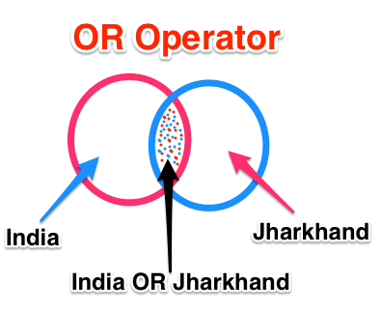
OR Operator
If one of your key concepts is “Jharkhand”, and “India” as conceptually related term.
To make sure you find all the relevant articles in a database you need to include both words in your search.

Slide 22
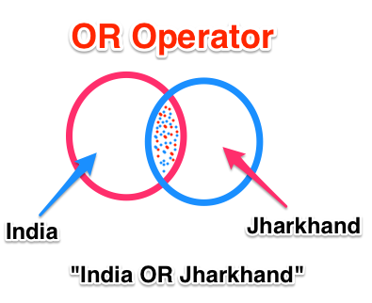
Or operator
Jharkhand OR India
Will retrieve all articles on
India
Jharkhand
Both
The OR operator
Adds terms
Broadens your search
|

Slide 23
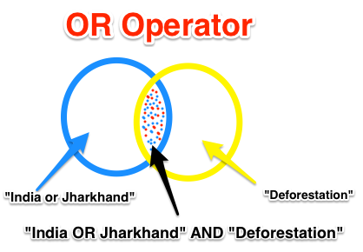
AND Operator
The AND operator works by combining different concepts and telling the computer to only find articles that always have both concepts.

Slide 24
AND operator
Will retrieve
India deforestation
Jharkhand deforestation
India or Jharkhand deforestation
The “AND” operator
combines terms
narrows your search
Both concepts must be present
&

Slide 25
NOT operator
Used for excluding records containing a term of whose chances are there to be included.
“Apple and Microsoft” NOT fruit
!

Slide 26
Truncation
Truncation is a search facility whereby a search can be conducted for all the different forms of a word having the same common root.
As an example, the truncated word COMPUT* will retrieve items on COMPUTER, COMPUTING, COMPUTATION, COMPUTE, etc.
Right truncation, left truncation, and masking of letters in the middle of the word.
Left truncation retrieves all words having the same characters at the right hand part, e.g., ‘*hyl’ will retrieve words like ‘methyl’, ‘ethyl’, etc.
Similarly, middle truncation retrieves all words having the same characters at the left and right hand part. For example, a middle truncated search term ‘col*r’ will retrieve both the terms ‘colour’ and ‘color’.
A ‘wild card’ is used to allow any letter to appear in a specific location within a word.

Slide 27
Proximity Search
This search facility allows user to specify
whether two search terms should occur adjacent to each other,
whether one or more words occur in between the search terms,
whether the search terms should occur in the same paragraph irrespective of the intervening words, and so on.
The operators used for proximity search and their meaning differ from one search system to the other.
A proximity search is as good as a Boolean AND search in the sense that it searches for the occurrence of two or more search terms in the documents.
However, it adds more constraints by specifying the distance between the search terms, and therefore the search output becomes more specific.
sun within 4 words after moon

Slide 28
Field Specific Search
When you want to specify to search in a particular field.
“Gandhi”
As author
As subject

Slide 29
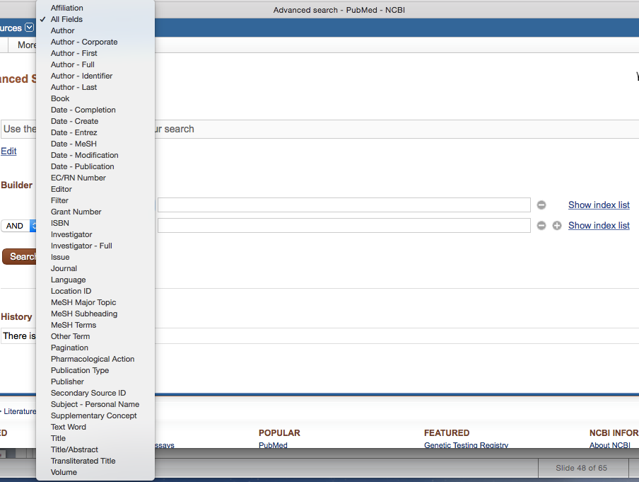

Slide 30
Limiting Search
Sometimes a user may want to limit a given search by using certain criteria, such as language, year of publication, type of information sources, and so on.
Parameters that can be used to limit a search are defined by the database.
Ex:
File type Search
Especially useful when you have reason to suspect that the answer you need will be in a certain format.
e.g. PDF
file-type:pdf “Human Resource Management”

Slide 31
Site specific search
This is useful when you want to control the quality of the search results, when you know a site that is likely to have what you need, and also when you want to find again a known document.
e.g. site:edu “Human resource management”

Slide 32
Range search
Range search is very useful with numerical information.
It is important in selecting records within certain date ranges.

